Slide 1



PEILab Group Meeting
Leader: Zicong Hong
Team Member: Jian Lin, Haodong Wang, Qianli Liu, Kaibin Guo, Junjie Liu

Slide 2
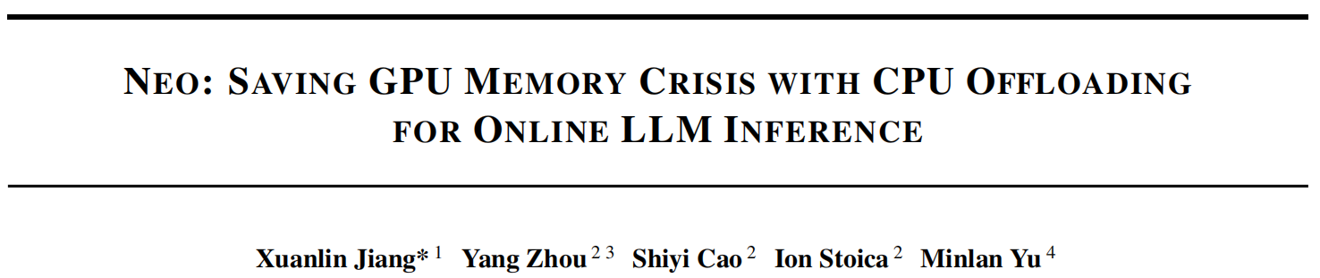
NEO
MLsys’25

Slide 3
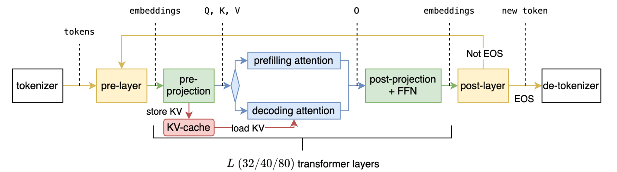
NEO

Slide 4
NEO
CPU Memory as a Possible Rescue
The decoding attention operation is memory-bandwidth_x0002_bounded on both GPU and CPU due to low arithmetic inten_x0002_sity (i.e., FLOP per memory load) (He & Zhai, 2024; Zhu
et al., 2024). The memory bandwidth gap between GPUs
and CPUs is much smaller than their compute gap. For
example, an A10G GPU features 600 GB/s memory band_x0002_width and 125 TFLOPS, while a modern x86 server has
around 200 GB/s memory bandwidth with 1.2 TFLOPS (He
& Zhai, 2024; Zhu et al., 2024); modern ARM processors
like AWS Graviton4 offer 537.6 GB/s memory bandwidth
per socket (WikiChip). Therefore, although there may seem
to be a huge compute gap between GPUs and CPUs (i.e.,
125 vs. 1.2 TFLOPS), the actual performance gap for the
decoding attention operation is relatively small because their
memory bandwidths are closer (i.e., 600 vs. 200 GB/s).

Slide 5
NEO
Challenge #1: How to efficiently overlap the GPU and CPU
within each inference iteration?
Challenge #2: How to schedule inference requests to the
GPU and CPU across inference iterations to maintain high
performance in dynamically-changing workloads?

Slide 6
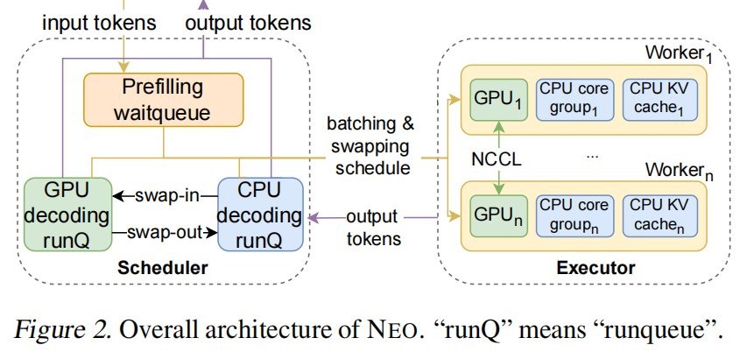
NEO

Slide 7
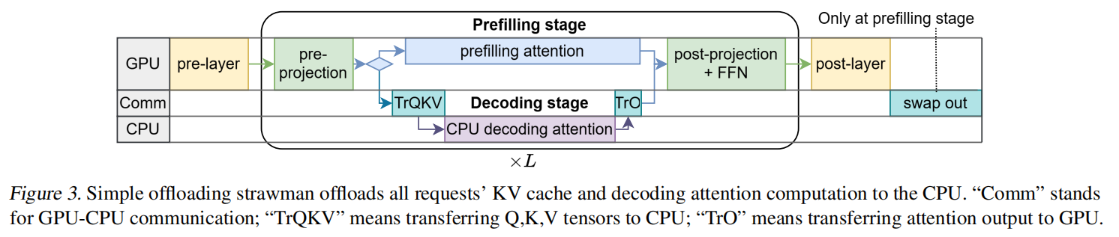
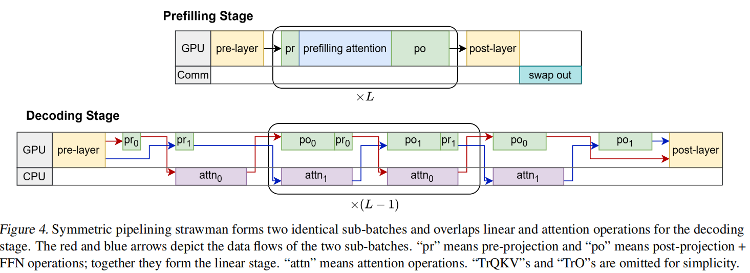
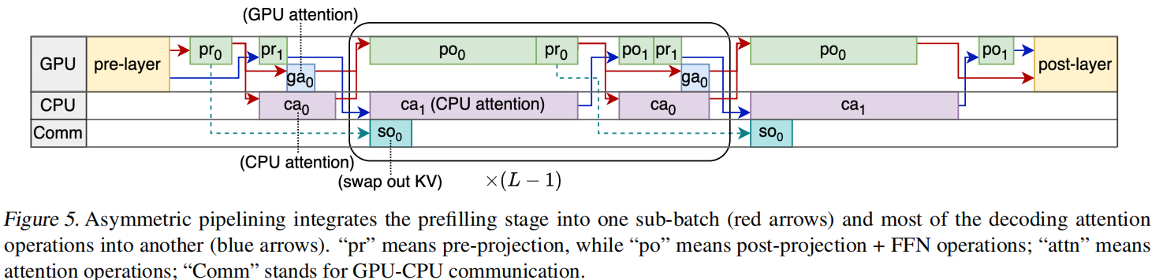
NEO

Slide 8
NEO

